Slide 1

CISC 250 – Business Telecomm Networks
Networking Fundamentals
Dr. Jinwei Cao
Dept. of ACCT & MIS
University of Delaware

Slide 2
Today’s Outline
Network & Internet
Network Performance Metrics
Network Structural Models
Protocols

Slide 3
Network
Application
Application
Server
Station
Client
Station
Warriors of the Net

Slide 4
The Internet
How Does the Internet Work?
A Network of Networks
Interconnected by Routers
Network X
Network Y
Switches
Network Z
Routers
Switches

Slide 5
Internet: network of networks
roughly hierarchical
at center: “tier-1” ISPs (e.g., Verizon, Sprint, Level 3, AT&T), national/international coverage
treat each other as equals
Tier-1 providers also interconnect at public network access points (NAPs)
Tier-1 providers interconnect (peer) privately
Tier 1 ISP
NAP
Tier 1 ISP
Tier 1 ISP
http://www.internetexchangemap.com/

Slide 6
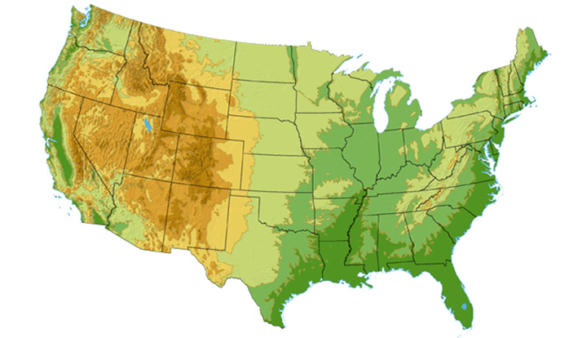

Tier-1 ISP: e.g., Sprint
Sprint US backbone network
DS3 (45 Mbps)
OC3 (155 Mbps)
OC12 (622 Mbps)
OC48 (2.4 Gbps)
Seattle
Tacoma
POP: point-of-presence
to/from backbone
Stockton
New York
Cheyenne
Chicago
Pennsauken
…
peering
….
Relay
San Jose
Roachdale
Wash. DC
Kansas City
Anaheim
…
…
…
Atlanta
to/from customers
Fort Worth
Orlando

Slide 7
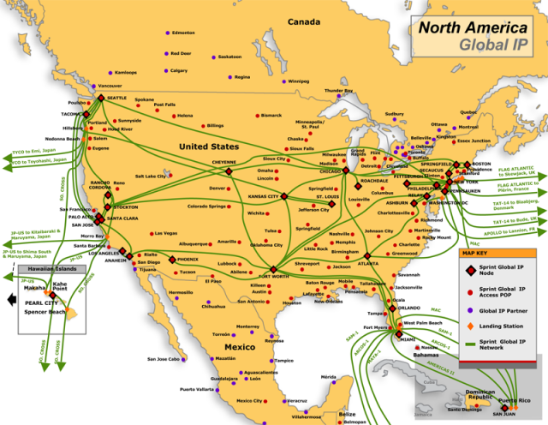

Slide 8
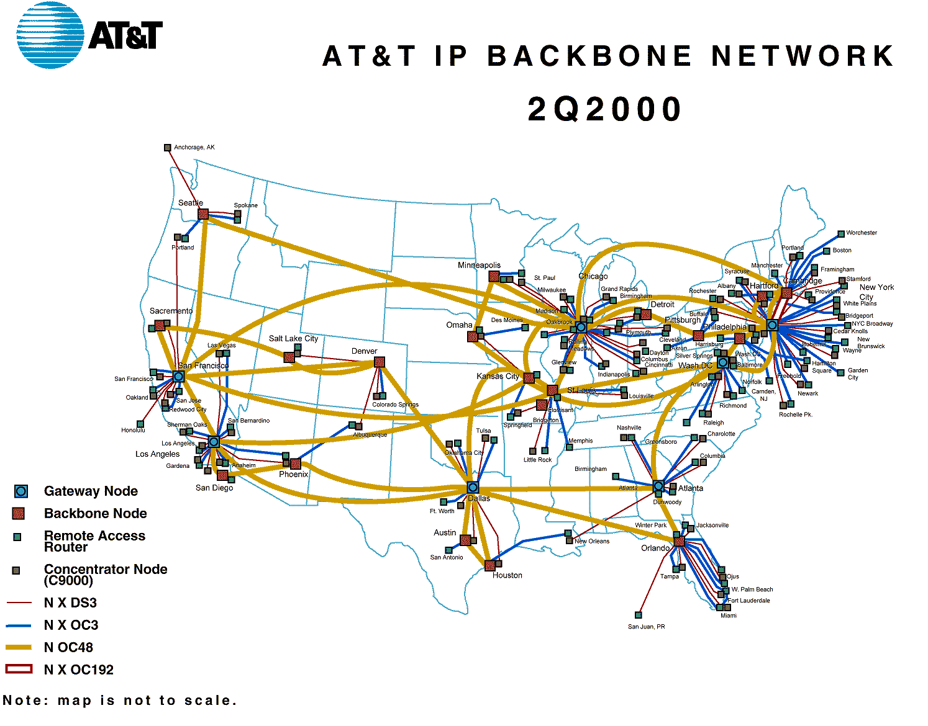

Slide 9
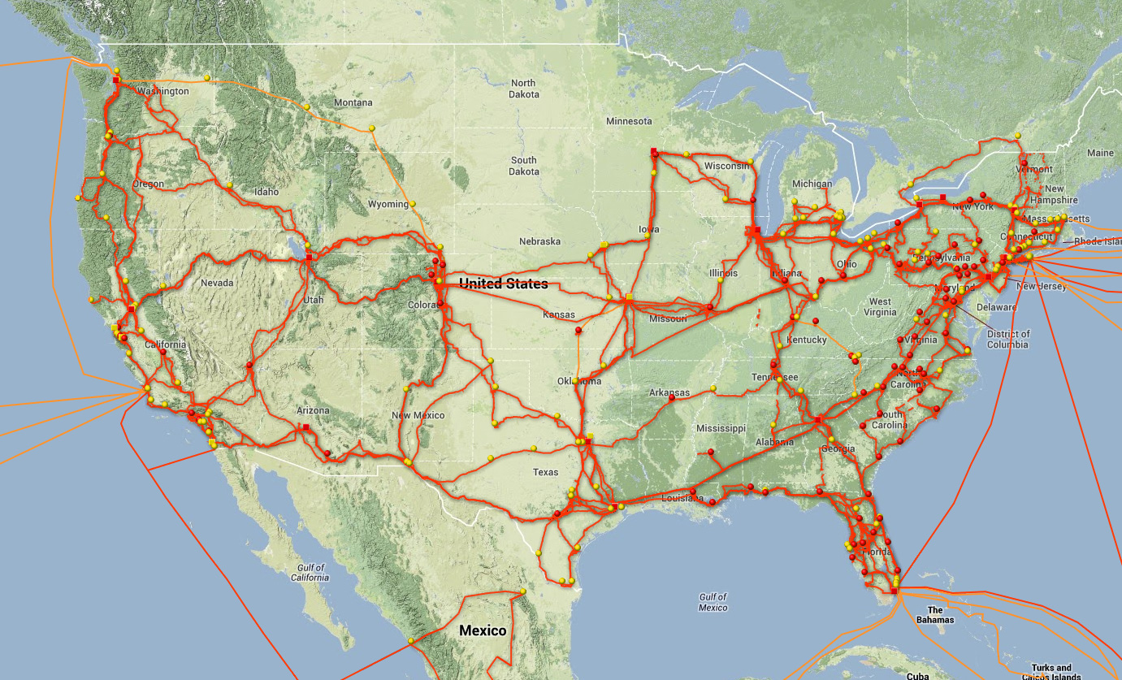
Level 3 Backbone

Slide 10
Internet: network of networks
“Tier-2” ISPs: smaller (often regional) ISPs (e.g., Comcast)
Connect to one or more tier-1 ISPs, possibly other tier-2 ISPs
Tier-2 ISPs also peer privately with each other, interconnect at NAP
Tier-2 ISP pays tier-1 ISP for connectivity to rest of Internet
tier-2 ISP is customer of
tier-1 provider
Tier-2 ISP
Tier-2 ISP
Tier 1 ISP
NAP
Tier 1 ISP
Tier 1 ISP
Tier-2 ISP
Tier-2 ISP
Tier-2 ISP

Slide 11
Internet: network of networks
“Tier-3” ISPs and local ISPs
last hop (“access”) network (closest to end systems)
local
ISP
Tier 3
ISP
local
ISP
local
ISP
local
ISP
Local and tier- 3 ISPs are customers of
higher tier ISPs
connecting them to rest of Internet
Tier-2 ISP
Tier-2 ISP
Tier 1 ISP
NAP
Tier 1 ISP
Tier 1 ISP
Tier-2 ISP
Tier-2 ISP
Tier-2 ISP
local
ISP
local
ISP
local
ISP
local
ISP

Slide 12
Internet: network of networks
a packet passes through many networks!
local
ISP
Tier 3
ISP
local
ISP
local
ISP
local
ISP
Tier-2 ISP
Tier-2 ISP
Tier 1 ISP
NAP
Tier 1 ISP
Tier 1 ISP
Tier-2 ISP
Tier-2 ISP
Tier-2 ISP
local
ISP
local
ISP
local
ISP
local
ISP

Slide 13

Partial map of the Internet based on the January 15, 2005 data found on opte.org. Each line is drawn between two nodes, representing two IP addresses. The length of the lines are indicative of the delay between those two nodes. This graph represents less than 30% of the Class C networks reachable by the data collection program in early 2005. Lines are color-coded according to their corresponding RFC 1918 allocation as follows:
Dark blue: net, ca, us
Green: com, org
Red: mil, gov, edu
Yellow: jp, cn, tw, au, de
Magenta: uk, it, pl, fr
Gold: br, kr, nl
White: unknown

Slide 14
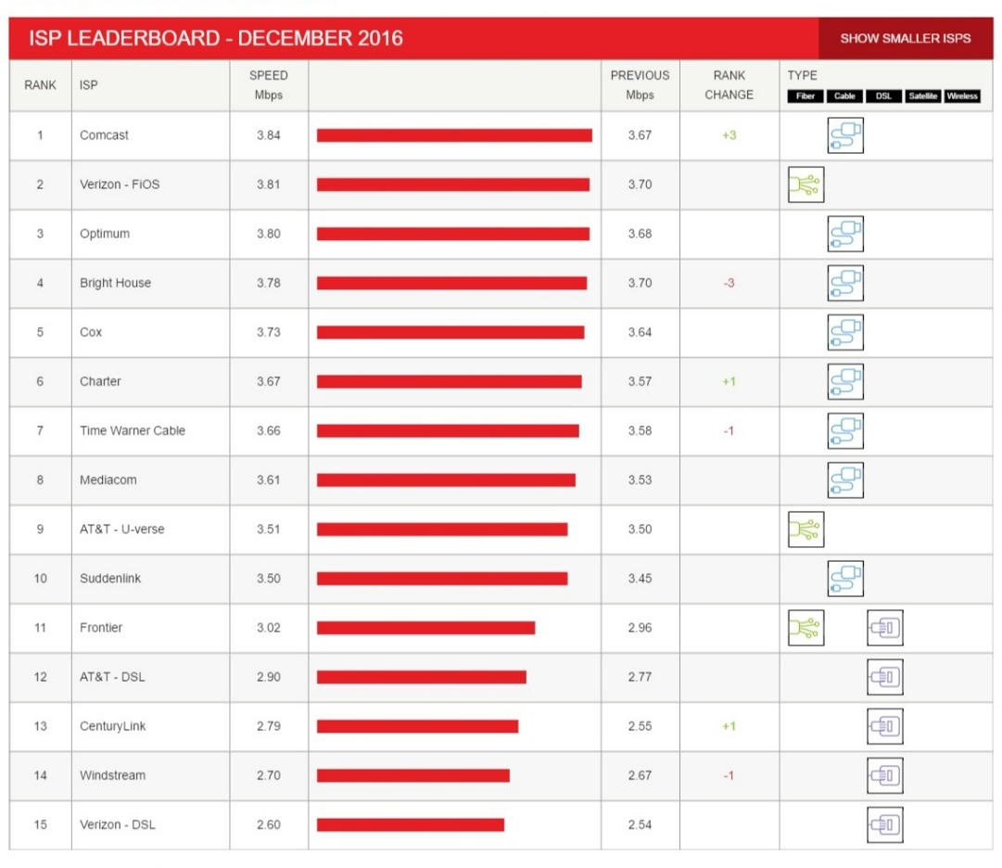
Netflix’s USA ISP Speed Index

Slide 15
The Future?
Click the links to watch videos
The Fight for the Open Internet
What is “Net Neutrality”?
Comcast, Level 3, and Netflix
PRISM & Xkeyscore
WikiLeaks
The Internet of Things

Slide 16
Network Performance Metrics
Bandwidth (capacity) / Throughput (actual)
data transmitted per time unit
Notation: bps = bits per second
Network speed test
Latency (delay)
time to send message from point A to point B
one-way versus round-trip time (RTT)
Latency = Propagation + Transmit + Queue
Propagation = Distance / propagation speed in medium (~2x10⁸ m/sec)
Transmit = Size / Bandwidth
Demo

Slide 17
Network Performance Metrics
Availability
Percent of time the network is available to users for transmission and reception
Want 24x7x365 availability
Telephone network: Five 9s (99.999%)
Error Rate
Percent of lost or damaged messages or bits

Slide 18
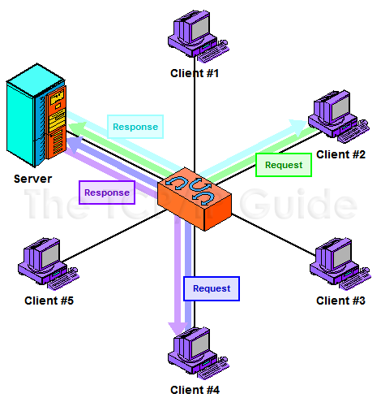
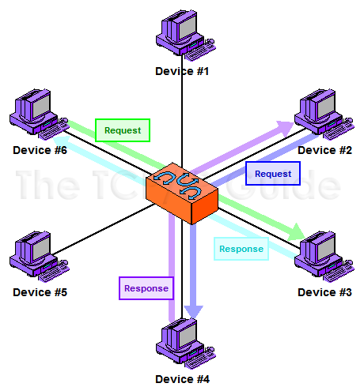
Network Structural Models
Client/Server
Peer-to-Peer

Slide 19
Thin clients and Cloud Computing
OS
Cloud
Desktop
Thin
Application
Client
Storage
The thin client has a limited processing power, memory or storage
Applications run on the web, in a “cloud” (see this video!)
Amazon offers basic services: storage, basic computing elements
Google offers more advanced services: word processors, spreadsheets, etc..
IBM offers Blue Cloud

Slide 20
Protocols
A protocol is an agreement about how communications are to proceed
Without a protocol communication can be difficult or even impossible
E.g. Telephone conversation, Postal addresses

Slide 21
Division of Protocols
Connection-Oriented
a logical connection be established between two devices before transferring data
a circuit is not a prerequisite for a connection
Circuit-switched => connection-oriented, but not all connection-oriented => circuit switching
Connectionless
do not establish a connection between devices

Slide 22
Packet Switching
1. Break message into
Smaller packets
(or frames)
Original Message
Packet
Switch
A
B
C
Computer X
Packet
Switching
Decision
Computer Y
F
D
E
2. Route packets individually;
Packet switches along the way
Make decisions about the packet

Slide 23
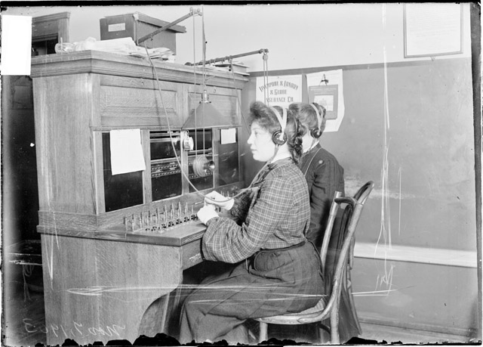
Circuit Switching

Slide 24


